Slide 1




Wind Energy Harvesting with a Kite
Antonin Bavoil¹, Jean-Baptiste Caillau¹, Lamberto Dell’Elce², Alain Nême³ , Jean-Baptiste Leroux³
1: Université Côte d’Azur, CNRS, Inria, LJAD
2: Inria
3: ENSTA Bretagne, iRDL
Julia and Optimization Days 2024
Toulouse, 29 October 2024

Slide 2
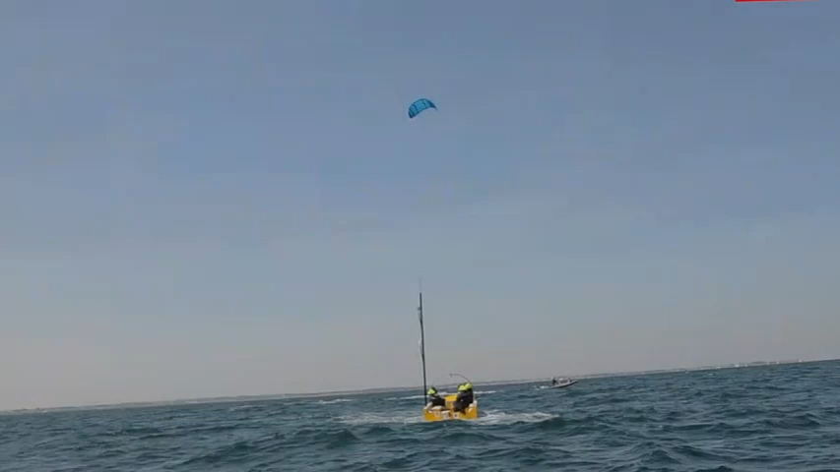
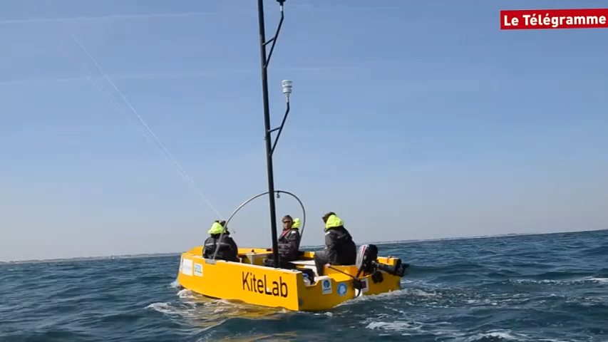
Kite Electrical Energy Production (KEEP)
KEEP is born as a follow up of Beyond the Sea®.
Idea: generate (on land) electricity with a kite.
10x less material than a wind turbine, soft.
Portable source of power in remote areas.
➝ Islands, military.
https://www.dailymotion.com/video/x5fwyox

Slide 3
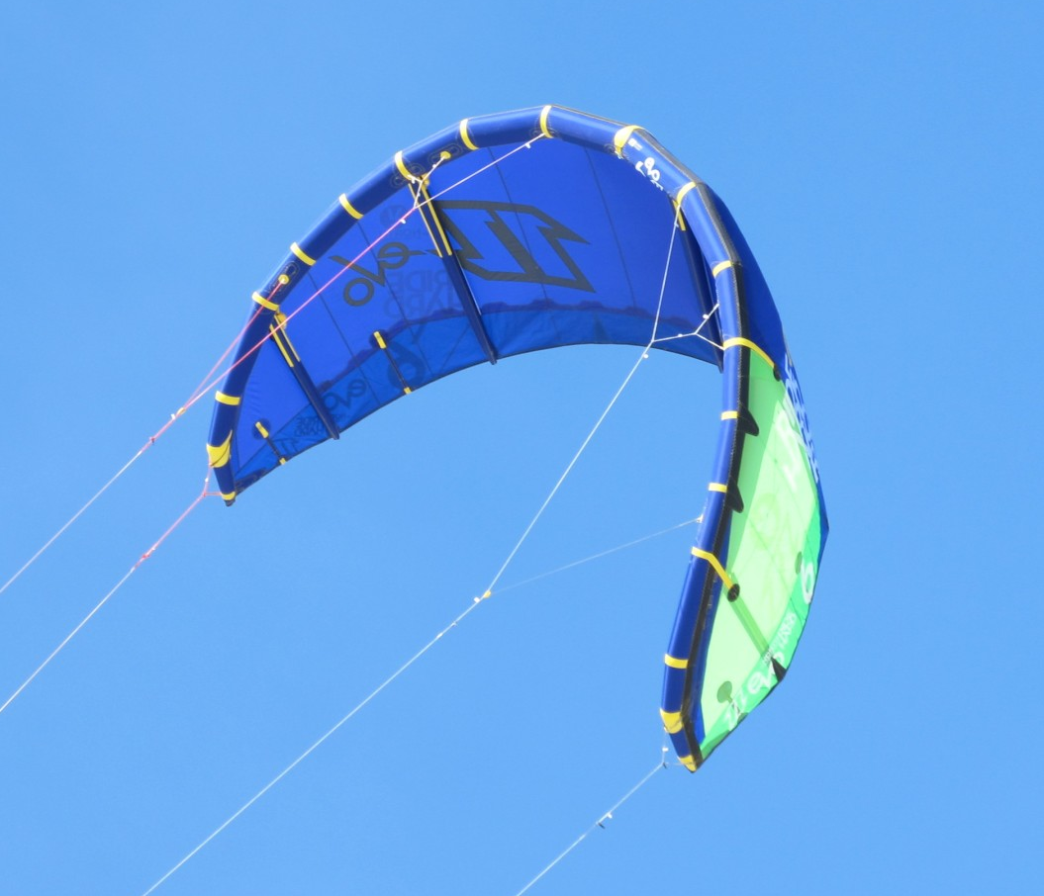
Kite Electrical Energy Production (KEEP)
Approximately the same power as a wind turbine.
Currently: 10% of the production used for control.
Previous works:
U. Ahrens, M. Diehl, R. Schmehl. Airborne Wind Energy. Springer, 2013,
U. Fechner et al. Dynamic Model of a Pumping Kite Power System, Pergamon, 2015.
Startup Kitepower, by J. Peschel and R. Schmehl, since 2016
➝ Can we generate a good amount of electricity while requiring close to no control?
https://www.iksurfmag.com/reviews/kites/north-kiteboarding-evo-6m-2013/

Slide 4
Wind Energy Harvesting with a Kite
Modelling
Numerical Results
Optimization problem

Slide 5
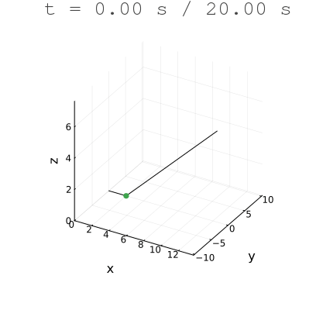
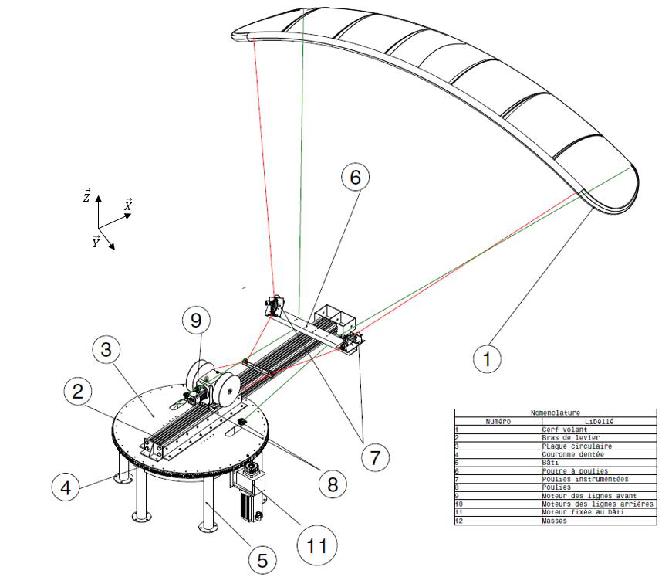
Modelling
➝ The kite does eights in the sky to swing the arm left to right as much as possible, without tangling the lines.

Slide 6
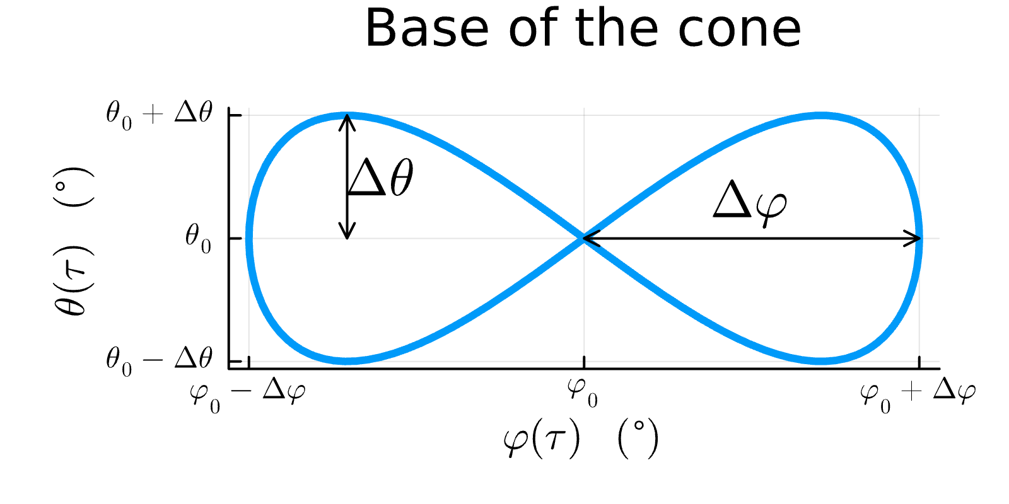
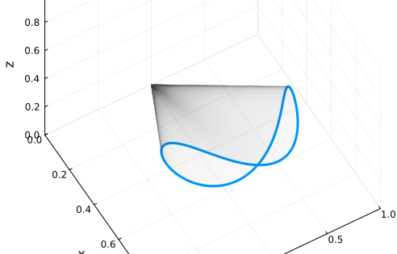
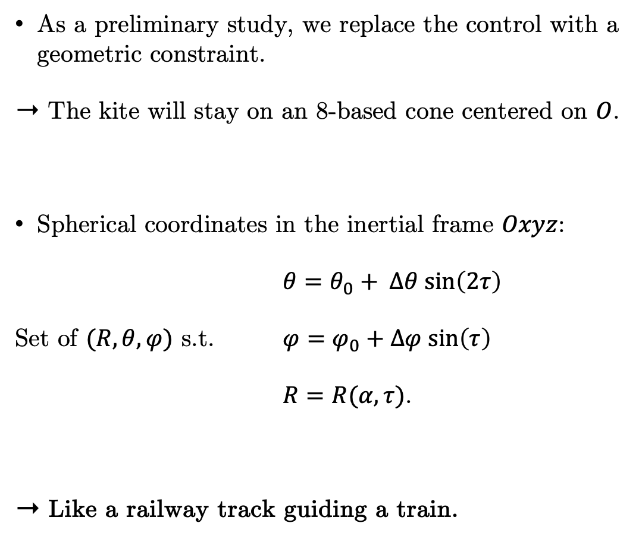
Modelling
Replacing the control with an algebraic constraint
As a preliminary study, we replace the control with a geometric constraint.
➝ The kite will stay on an 8-based cone centered on $O$.
Spherical coordinates in the inertial frame $Oxyz$:
$θ=θ_{0}+ Δθ sin\left(2τ\right)$
Set of $(R, θ, φ)$ s.t. $φ=φ_{0}+Δφ sin\left(τ\right)$
$R=R(α, τ)$.
➝ Like a railway track guiding a train.

Slide 7

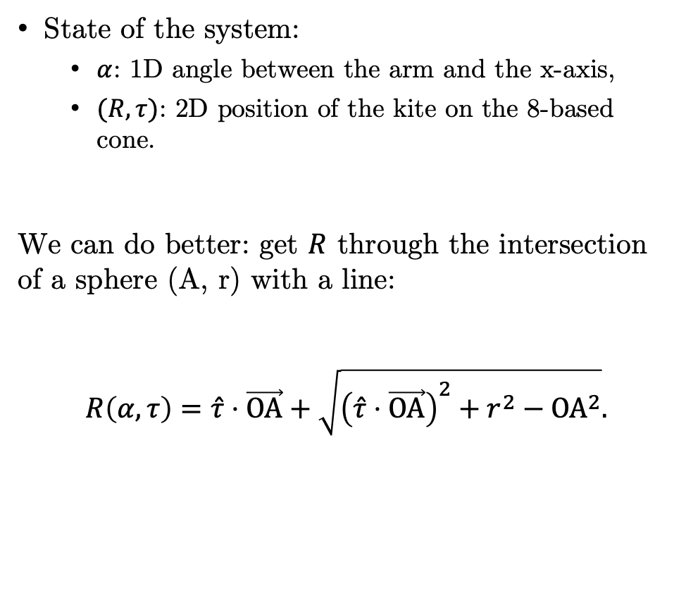
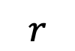
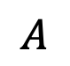
Modelling
Coordinates
State of the system:
$α$: 1D angle between the arm and the x-axis,
$(R, τ)$: 2D position of the kite on the 8-based cone.
We can do better: get $R$ through the intersection of a sphere (A, r) with a line:
$$R\left(α, τ\right)=\hat{τ}⋅\vec{OA}+\sqrt{{\left(\hat{τ}⋅\vec{OA}\right)}^{2}+r^{2}−{OA}^{2}}.$$
+
$$R?$$
$$A$$
$$r$$
➝ $(α, τ)$ is enough to determine the state of the system.

Slide 8

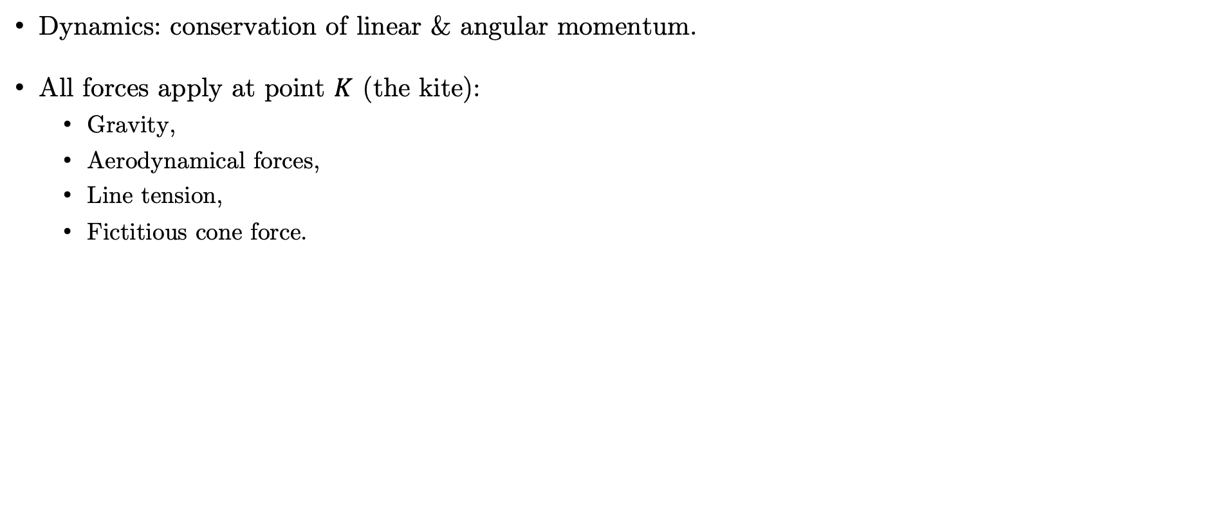


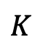

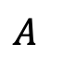

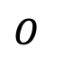
Modelling
Compute the dynamics
Dynamics: conservation of linear & angular momentum.
All forces apply at point $K$ (the kite):
Gravity,
Aerodynamical forces,
Line tension,
Fictitious cone force.
$$\hat{z}$$
Kite
$$K$$
Wind
$$R$$
Lines
$$\hat{y}$$
Generator
Arm
$$O$$
$$A$$
$$\hat{x}$$
$$α$$

Slide 9
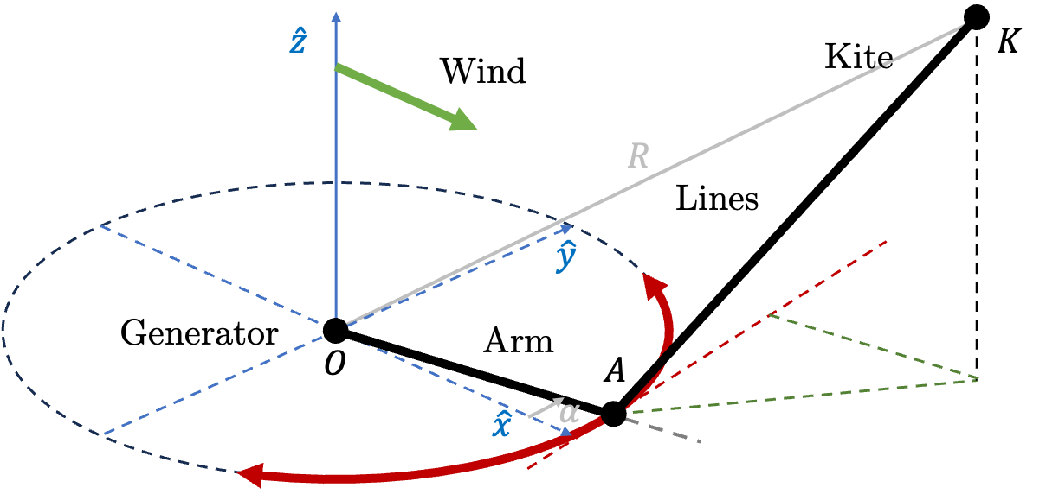
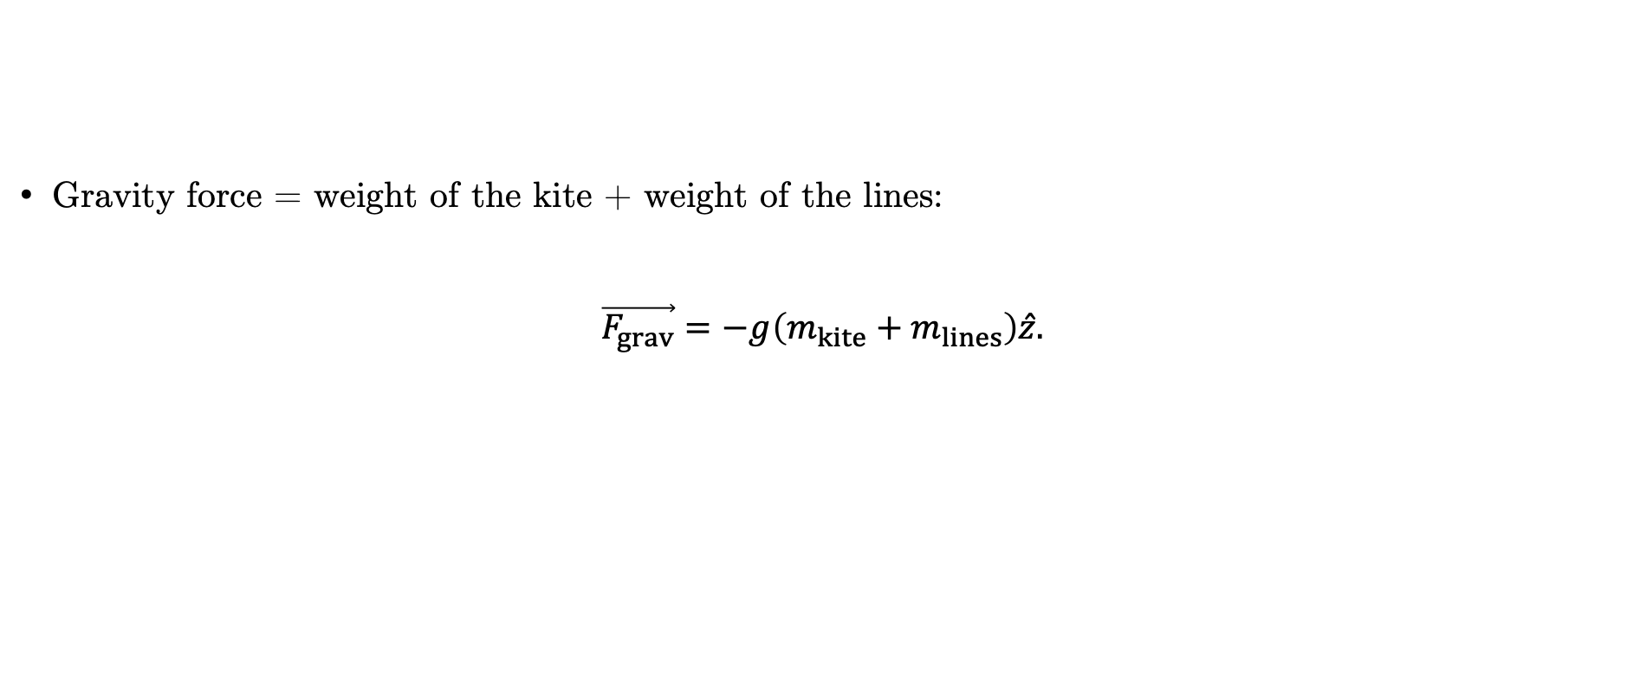
Modelling
Gravity
Gravity force = weight of the kite + weight of the lines:
$$\vec{F_{grav}}=−g\left(m_{kite}+m_{lines}\right)\hat{z}.$$

Slide 10
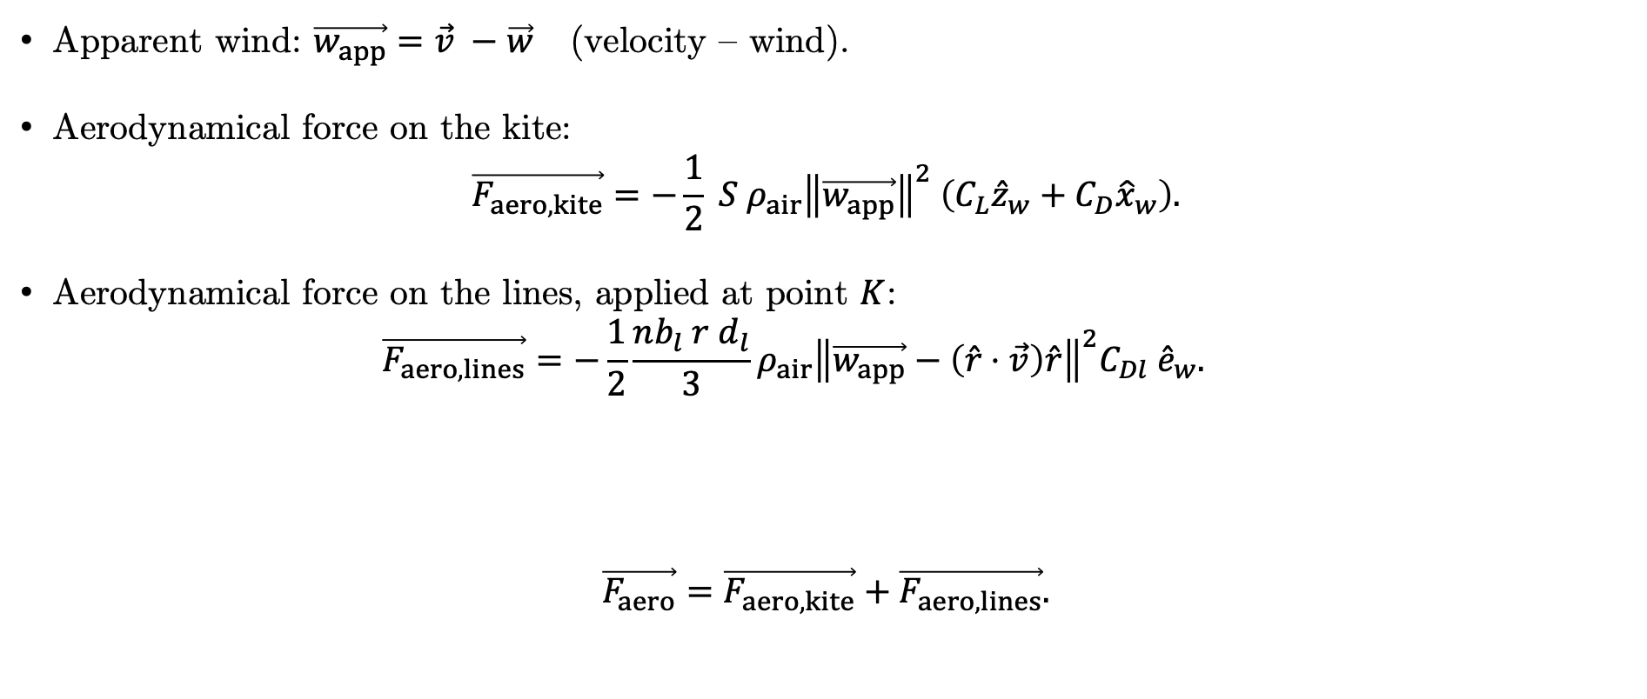
Modelling
Aerodynamical forces
Apparent wind: $\vec{w_{app}}=\vec{v} −\vec{w}$ (velocity – wind).
Aerodynamical force on the kite:
$$\vec{F_{aero, kite}}=−\frac{1}{2} S {ρ_{air}\left\|\vec{w_{app}}\right\|}^{2} \left({C_{L}{\hat{z}}_{w}+C}_{D}{\hat{x}}_{w}\right).$$
Aerodynamical force on the lines, applied at point $K$:
$$\vec{F_{aero,lines}}=−\frac{1}{2}\frac{nb_{l} r d_{l}}{3}ρ_{air}{\left\|\vec{w_{app}}−\left(\hat{r}⋅\vec{v}\right)\hat{r}\right\|}^{2}C_{Dl} {\hat{e}}_{w}.$$
$$\vec{F_{aero}}=\vec{F_{aero, kite}}+\vec{F_{aero, lines}}.$$

Slide 11
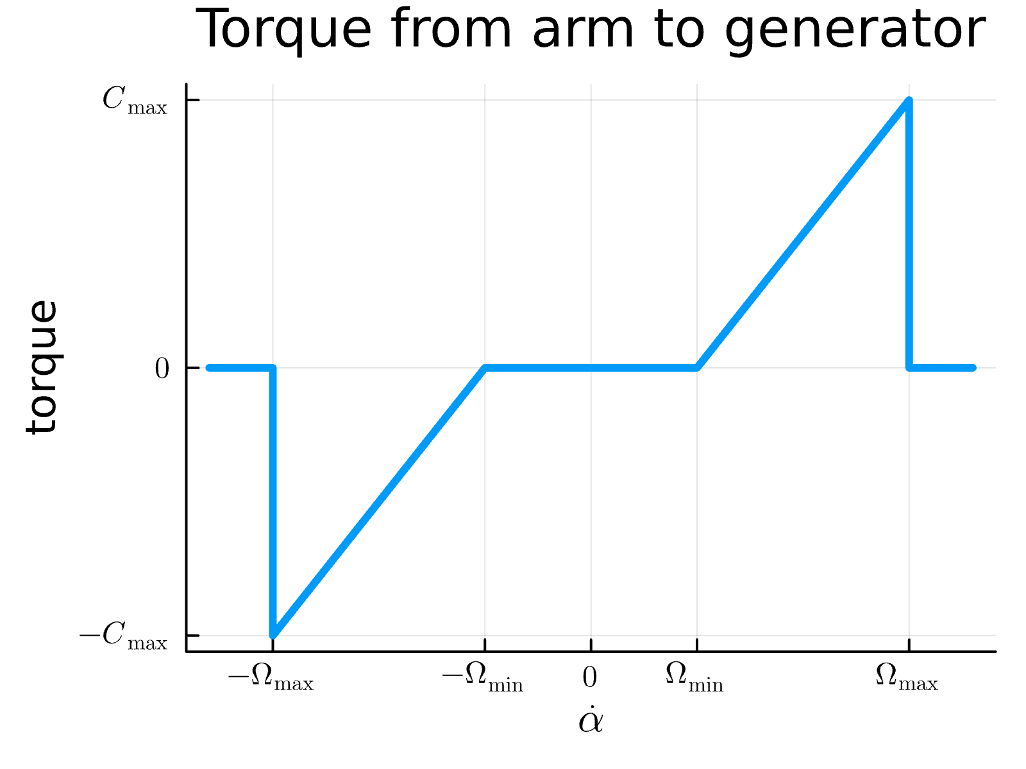
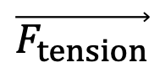
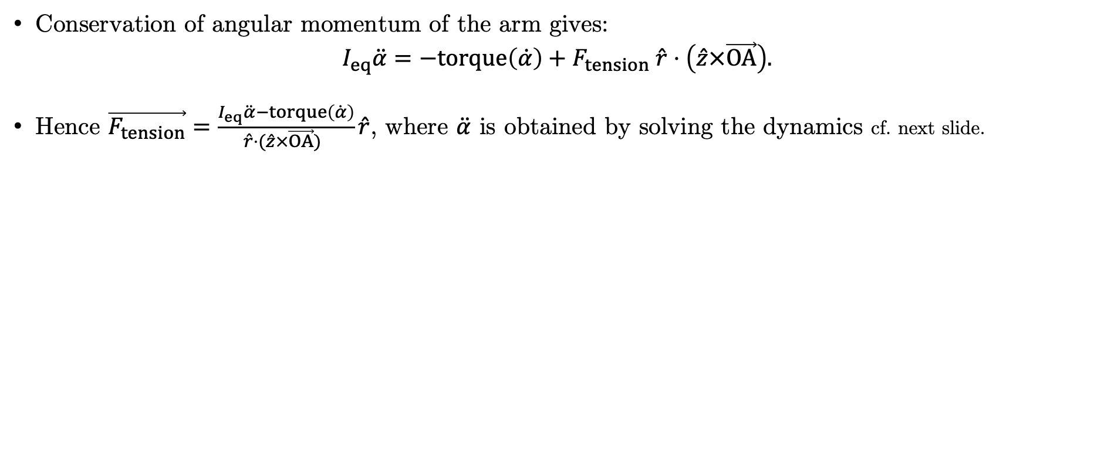

Modelling
Line tension & conservation of angular momentum
Conservation of angular momentum of the arm gives:
$$I_{eq}\ddot{α}=−torque\left(\dot{α}\right)+F_{tension} \hat{r}⋅\left(\hat{z}×\vec{OA}\right).$$
Hence $\vec{F_{tension}}=\frac{I_{eq}\ddot{α}−torque\left(\dot{α}\right)}{\hat{r}⋅(\hat{z}×\vec{OA}) }\hat{r}$, where $\ddot{α}$ is obtained by solving the dynamics cf. next slide.
$$\vec{F_{tension}}$$
$$\hat{r}$$

Slide 12
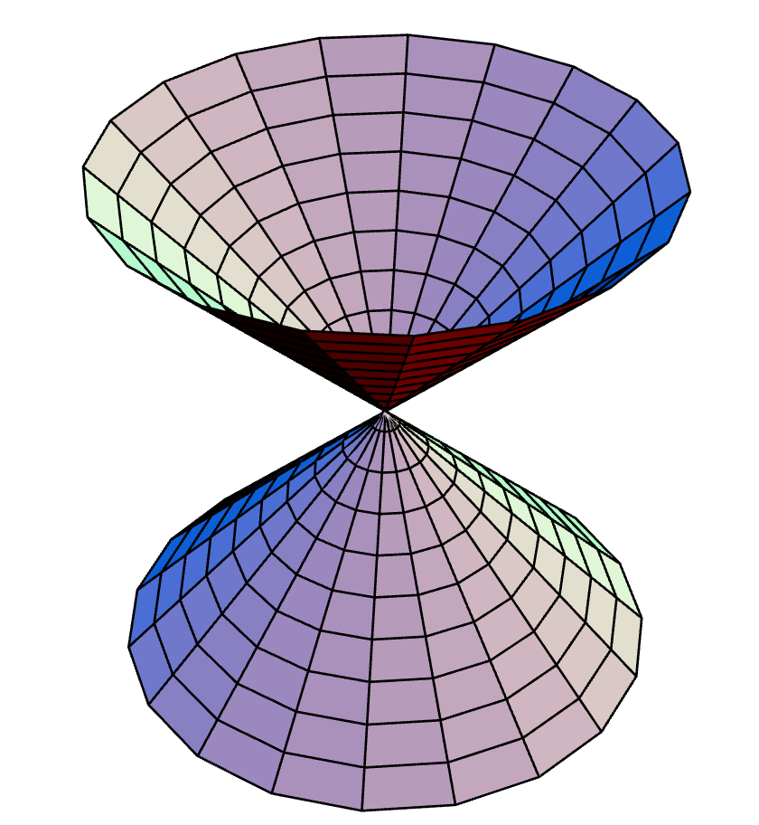
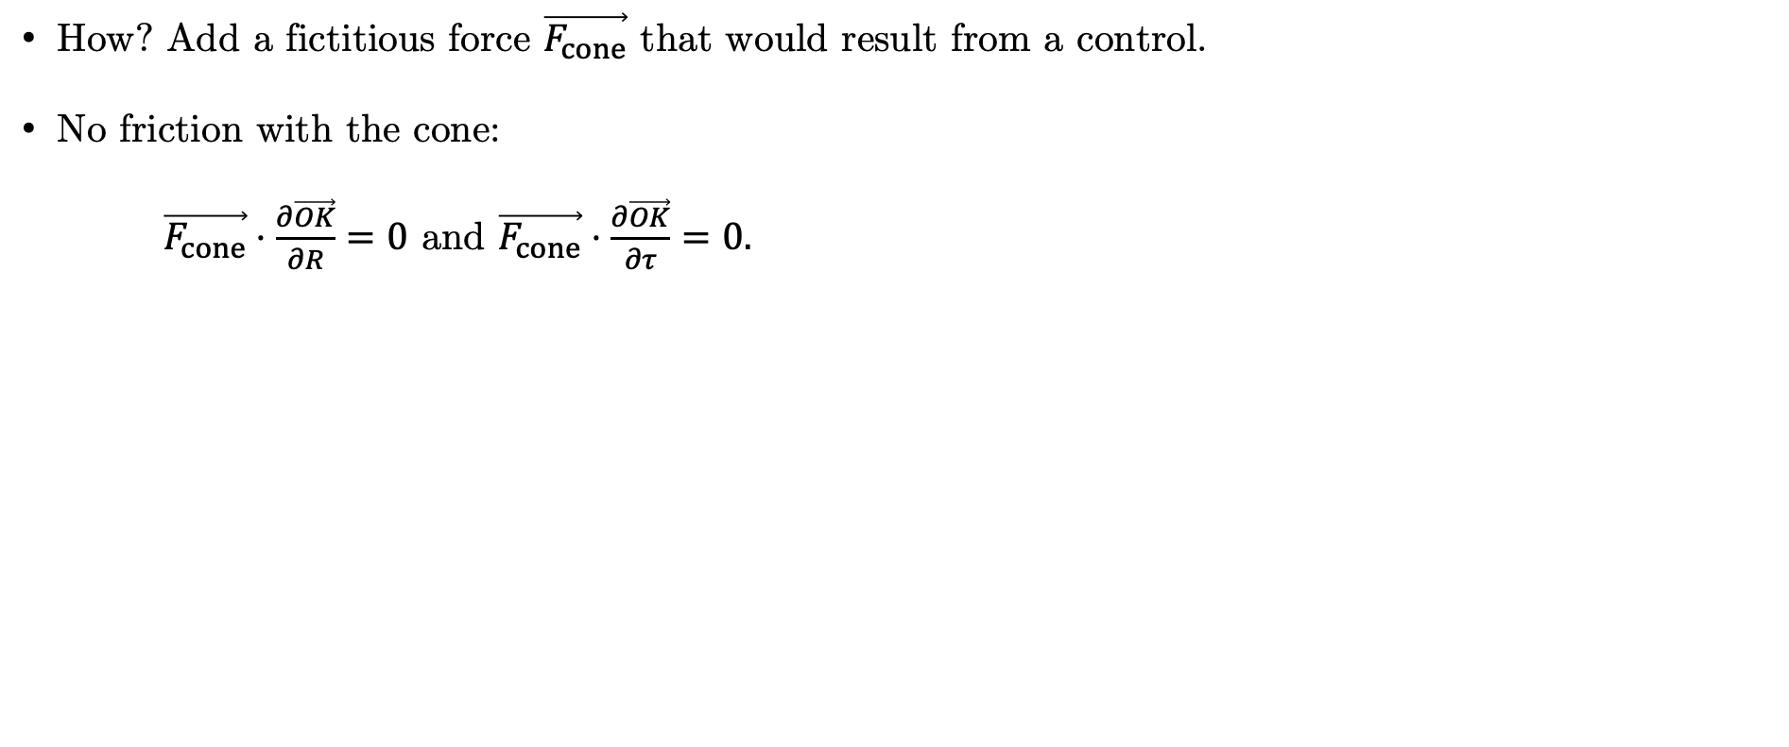
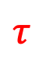

Modelling
Replacing the control with an algebraic constraint
How? Add a fictitious force $\vec{F_{cone}}$ that would result from a control.
No friction with the cone:
$\vec{F_{cone}}⋅\frac{∂\vec{OK}}{∂R}=0$ and $\vec{F_{cone}}⋅\frac{∂\vec{OK}}{∂τ}=0.$
Circle-based cone
$$R$$
$$τ$$
https://mathworld.wolfram.com/Cone.html

Slide 13
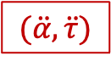
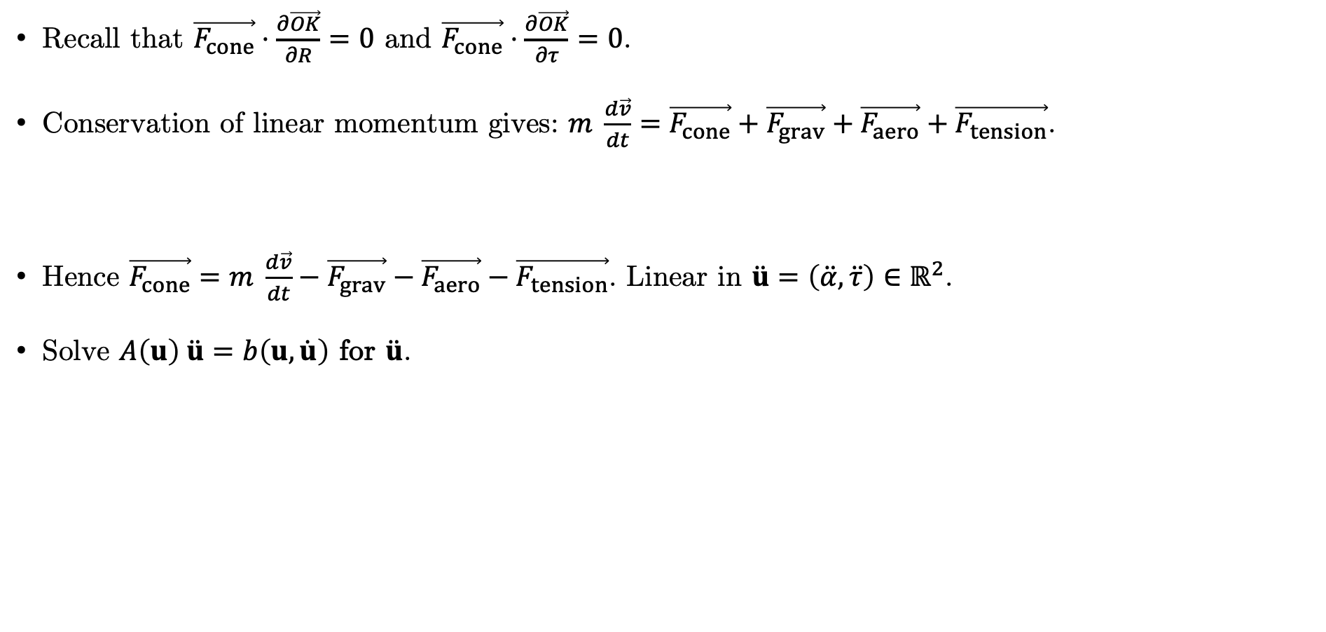

Modelling
Computing the explicit dynamics
Recall that $\vec{F_{cone}}⋅\frac{∂\vec{OK}}{∂R}=0$ and $\vec{F_{cone}}⋅\frac{∂\vec{OK}}{∂τ}=0$.
Conservation of linear momentum gives: $m \frac{d\vec{v}}{dt}=\vec{F_{cone}}+\vec{F_{grav}}+\vec{F_{aero}}+\vec{F_{tension}}$.
Hence $\vec{F_{cone}}=m \frac{d\vec{v}}{dt}−\vec{F_{grav}}−\vec{F_{aero}}−\vec{F_{tension}}$. Linear in $\ddot{u}=\left(\ddot{α}, \ddot{τ}\right)∈ℝ^{2}$.
Solve $A\left(u\right) \ddot{u}=b\left(u,\dot{u}\right)$ for $\ddot{u}$.
$$(\ddot{α}, \ddot{τ})$$
$$\ddot{α}$$

Slide 14
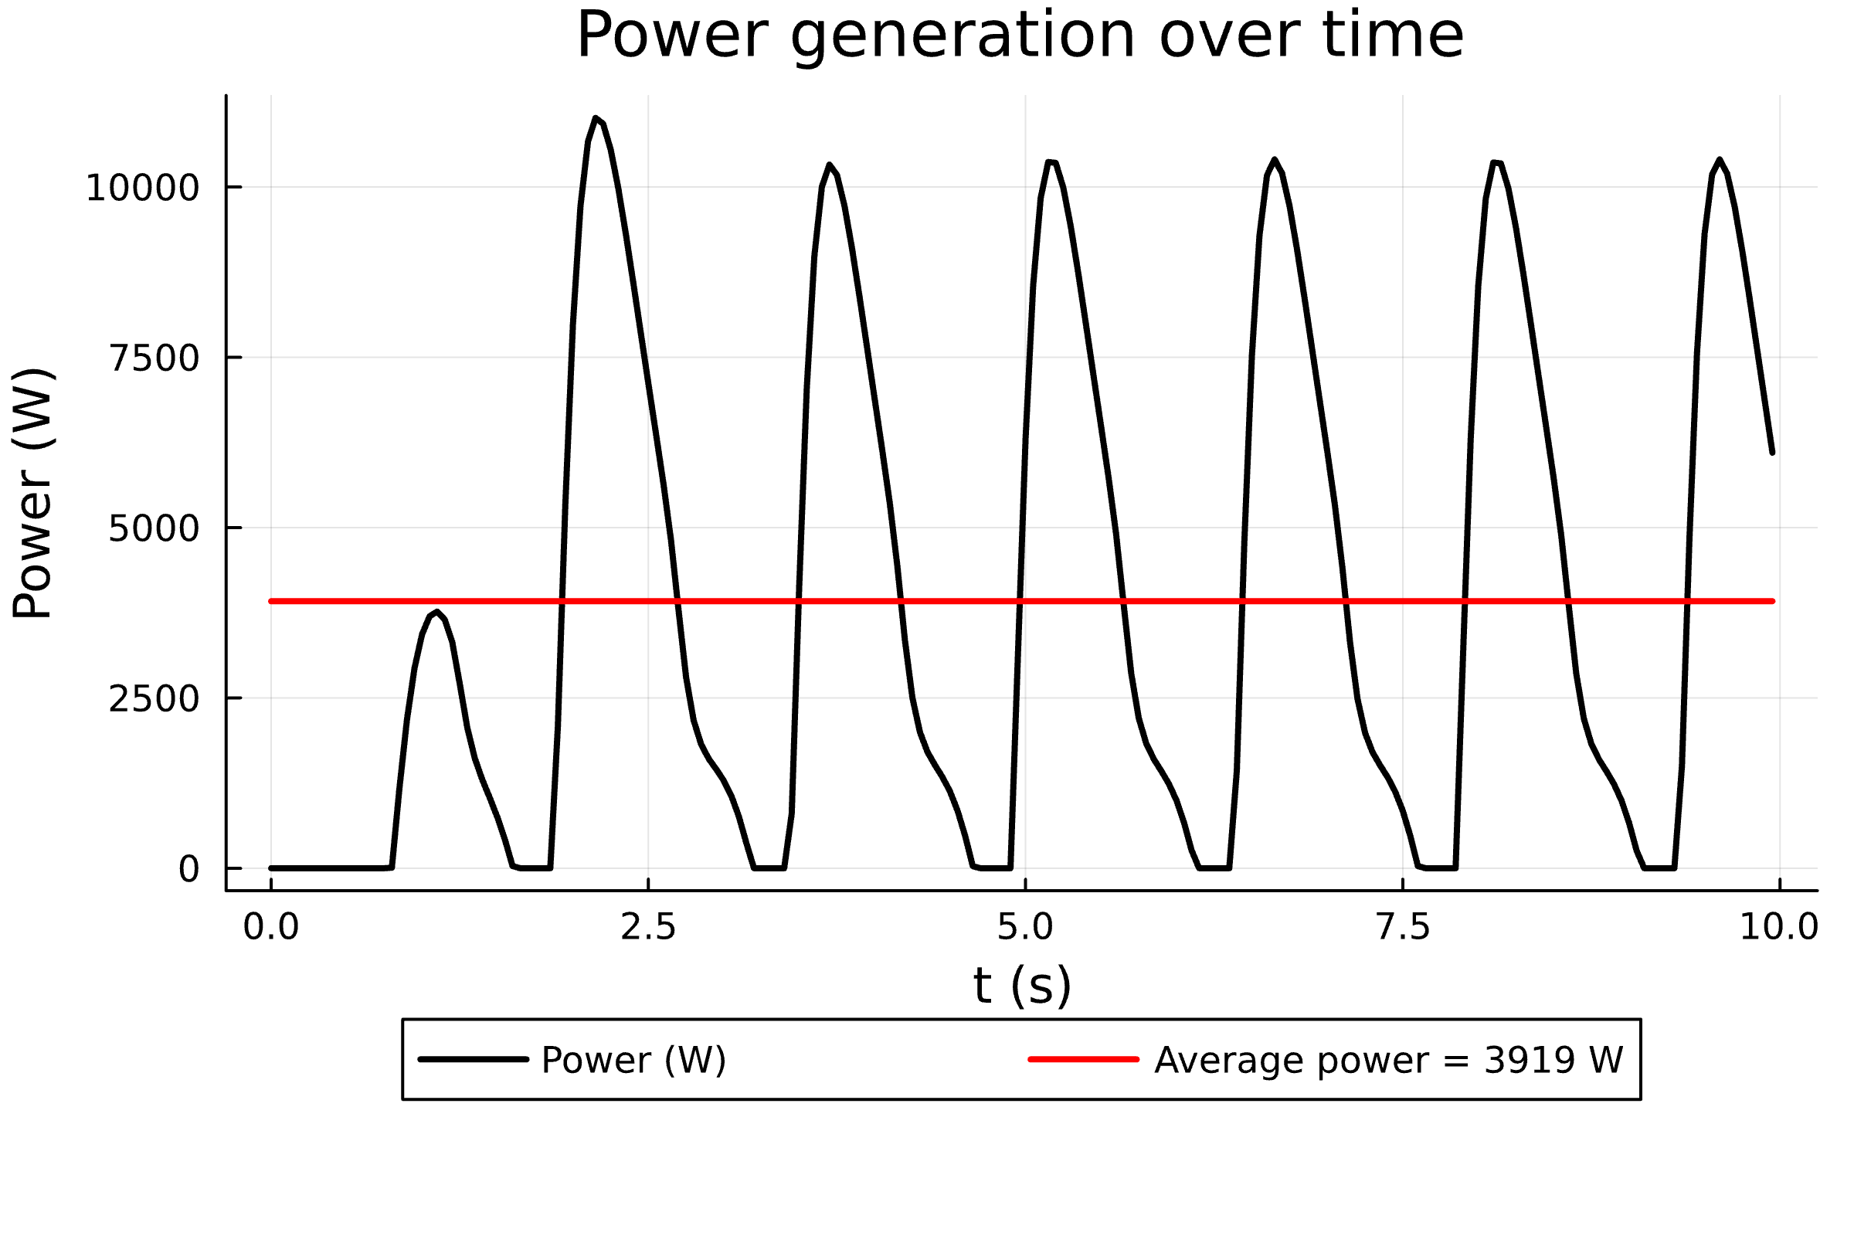
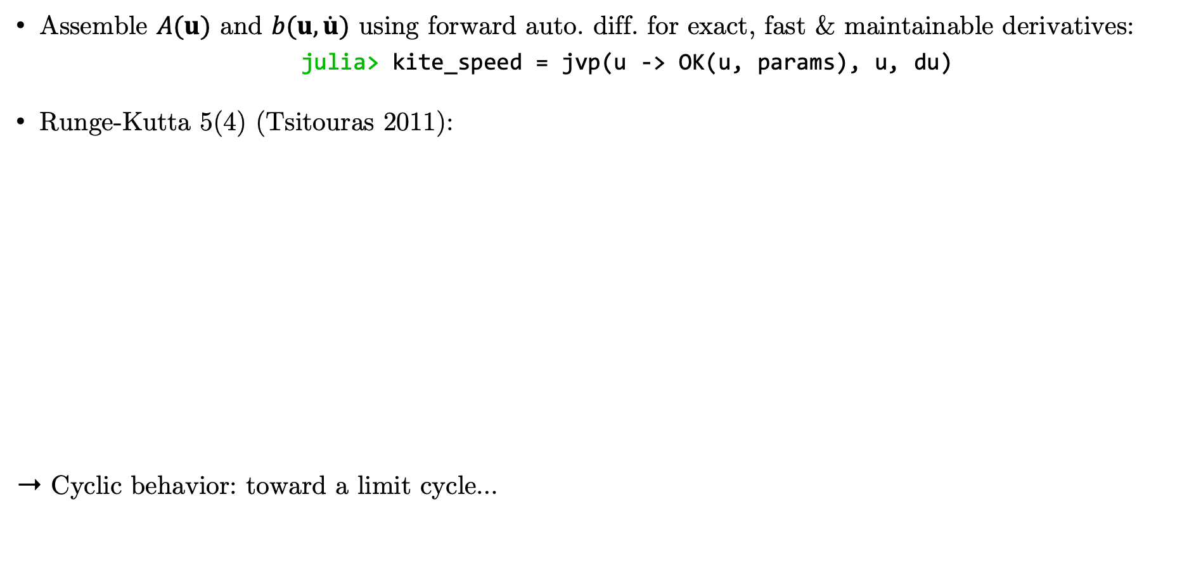
First Numerical Results
Solving the dynamics
Assemble $A(u)$ and $b(u, \dot{u})$ using forward auto. diff. for exact, fast & maintainable derivatives:
julia> kite_speed = jvp(u -> OK(u, params), u, du)
Runge-Kutta 5(4) (Tsitouras 2011):
➝ Cyclic behavior: toward a limit cycle…

Slide 15
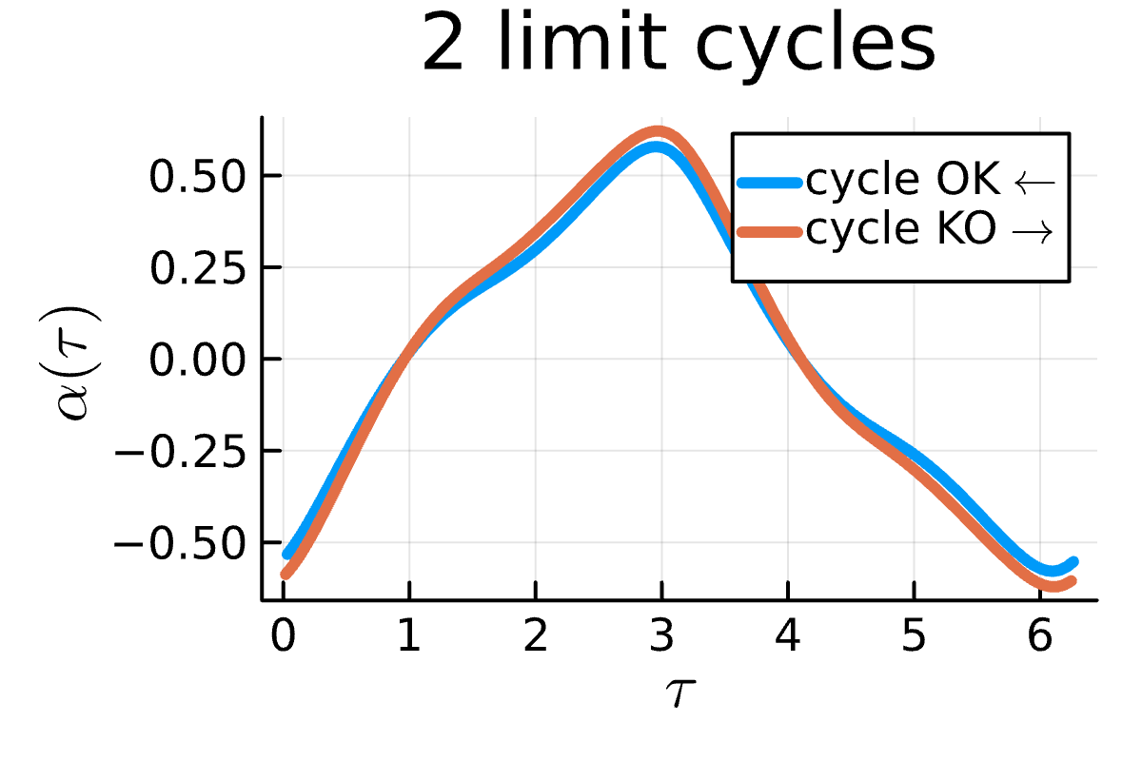
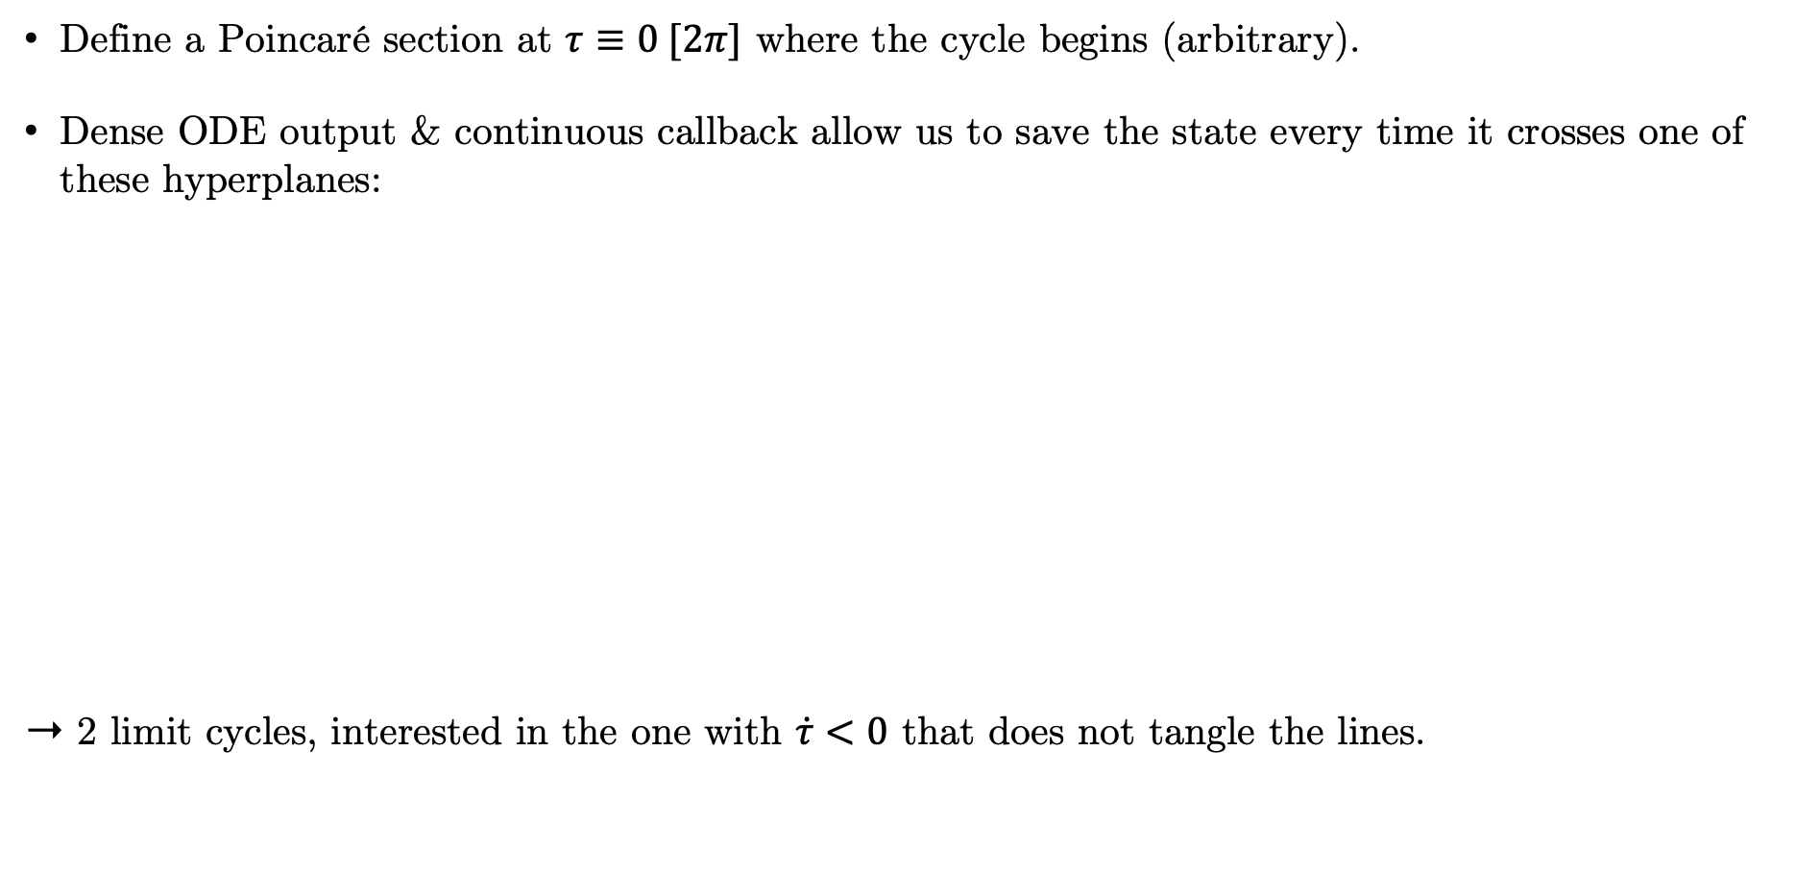
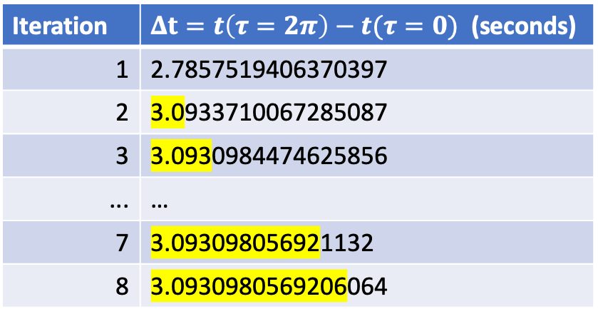
First Numerical Results
Limit Cycle
Define a Poincaré section at $τ≡0 [2π]$ where the cycle begins (arbitrary).
Dense ODE output & continuous callback allow us to save the state every time it crosses one of these hyperplanes:
➝ 2 limit cycles, interested in the one with $\dot{τ}<0$ that does not tangle the lines.
Iteration | $Δt=t\left(τ=2π\right)−t(τ=0)$ (seconds)
1 | 2.7857519406370397
2 | 3.0933710067285087
3 | 3.0930984474625856
... | …
7 | 3.093098056921132
8 | 3.0930980569206064

Slide 16
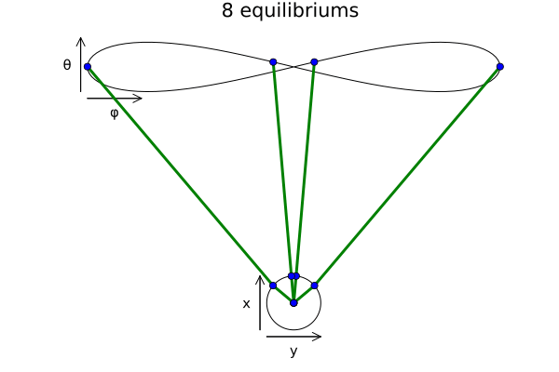
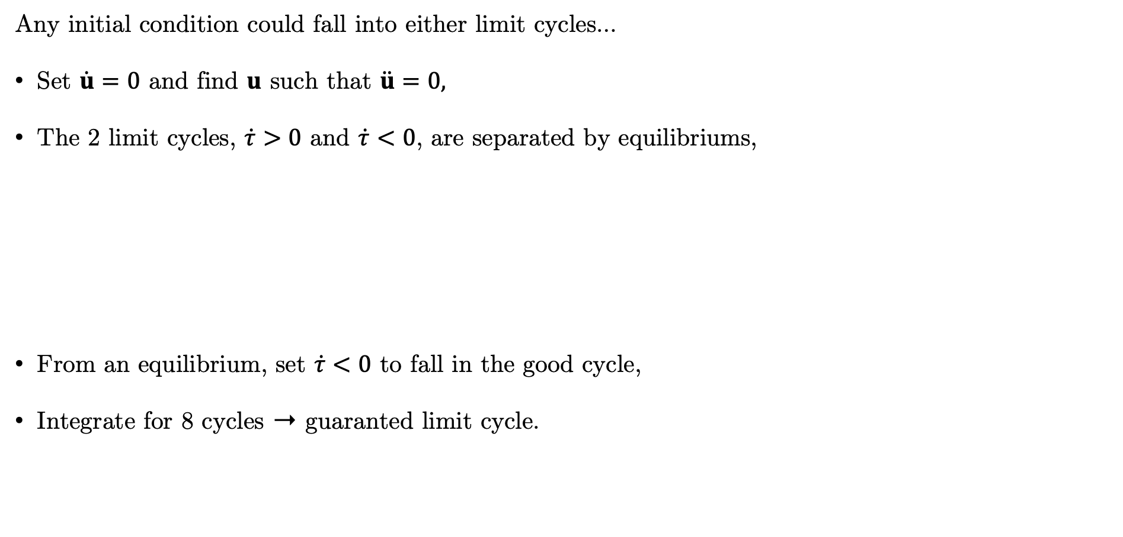
First Numerical Results
Equilibriums
Any initial condition could fall into either limit cycles…
Set $\dot{u}=0$ and find $u$ such that $\ddot{u}=0,$
The 2 limit cycles, $\dot{τ}>0$ and $\dot{τ}<0$, are separated by equilibriums,
From an equilibrium, set $\dot{τ}<0$ to fall in the good cycle,
Integrate for 8 cycles ➝ guaranted limit cycle.

Slide 17
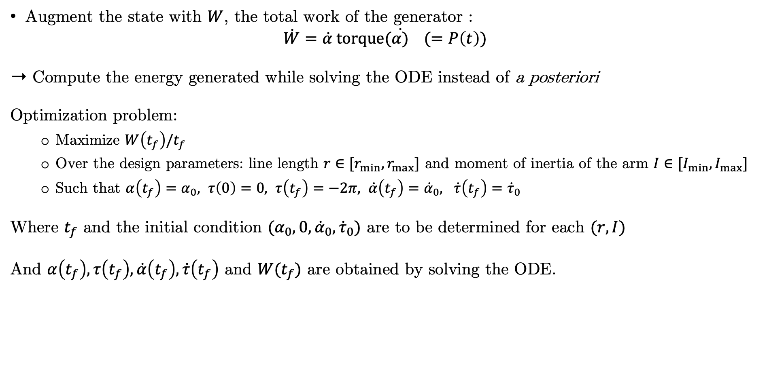
Optimization
Problem: Maximize the Average Power over a limit cycle
Augment the state with $W$, the total work of the generator :
$$\dot{W}=\dot{α} torque(\dot{α)} (=P\left(t\right))$$
➝ Compute the energy generated while solving the ODE instead of a posteriori
Optimization problem:
Maximize $W\left(t_{f}\right)/t_{f}$
Over the design parameters: line length $r∈[r_{min}, r_{max}]$ and moment of inertia of the arm $I∈[I_{min}, I_{max}]$
Such that $α\left(t_{f}\right)=α_{0}, τ\left(0\right)=0, τ\left(t_{f}\right)=−2π, \dot{α}\left(t_{f}\right)={\dot{α}}_{0}, \dot{τ}\left(t_{f}\right)={\dot{τ}}_{0}$
Where $t_{f}$ and the initial condition $(α_{0}, 0, {\dot{α}}_{0}, {\dot{τ}}_{0})$ are to be determined for each $(r, I)$
And $α\left(t_{f}\right), τ\left(t_{f}\right), \dot{α}\left(t_{f}\right), \dot{τ}\left(t_{f}\right)$ and $W(t_{f})$ are obtained by solving the ODE.

Slide 18
Optimization
Problem: Maximize the Average Power over a limit cycle
Most implicit
optvar = (r, I)
function objective(r, I)
determine tf, x0 such that they produce a limit cycle
integrate the ODE
return W(tf)/tf
end
A function gives the limit cycle for (r, I)
An ODE solver gives W(tf)
No nonlinear constraints
More explicit
optvar = (r, I, tf, α0, dα0, dτ0, Wf)
function objective(optvar)
return optvar.W/tf
End
function nlconstraints(optvar)
α(tf) – α0
τf – 2π
dα(tf) – dα0
dτ(tf) – dτ0
W(tf) – Wf
end
An ODE solver gives _(tf)
5 nonlinear constraints
Most explicit
optvar = (r, I, tf, α0, dα0, dτ0, α[2:N+1], τ[2:N+1], dα[2:N+1], dτ[2:N+1], W[2:N+1])
function objective(optvar)
return W[N+1]/tf
end
function nlconstraints(optvar)
x(i+1) - xi - h*f(x(i)), i=1:N
τ[N+1] – 2π
α[N+1] - α0
dα[N+1] - dα0
dτ[N+1] - dτ0
end
Implement own fixed-step ODE solver
N+5 nonlinear constraints

Slide 19
Optimization
Summary
Define a dynamics ForwardDiff.jl, ComponenArrays.jl
Solve the ODE problem and realize it converges toward a limit cycle OrdinaryDiffEq.jl, Plots.jl
Find the equilibriums of the system to systematically compute the correct limit cycle DiffEqCallbacks.jl, NonlinearSolve.jl
Define an optimization problem and initialize on a limit cycle, where constraints are satisfied GCMAES.jl, ADNLPModels.jl & NLPModelsIpopt.jl
What’s next ?
Sensibility analysis for guiding the engineering of a prototype
Moving forward to an optimal control model, without the cone constraint
Make the code publicly available

Slide 20
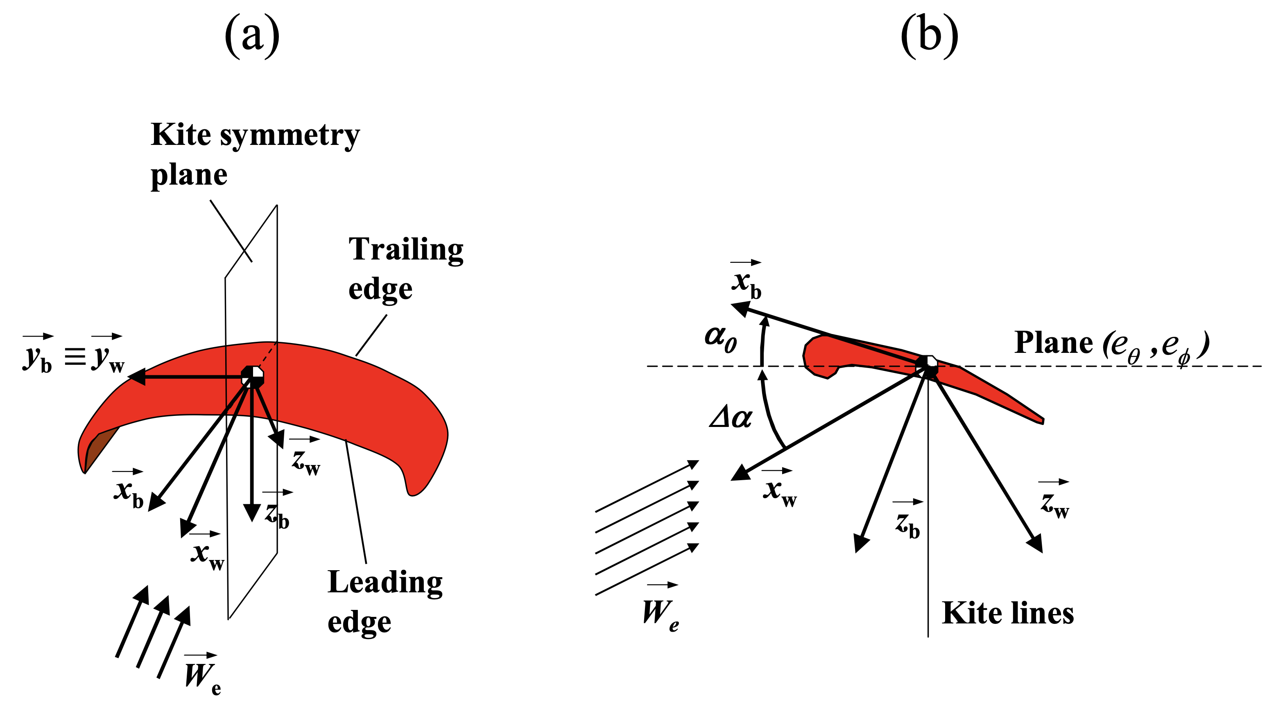
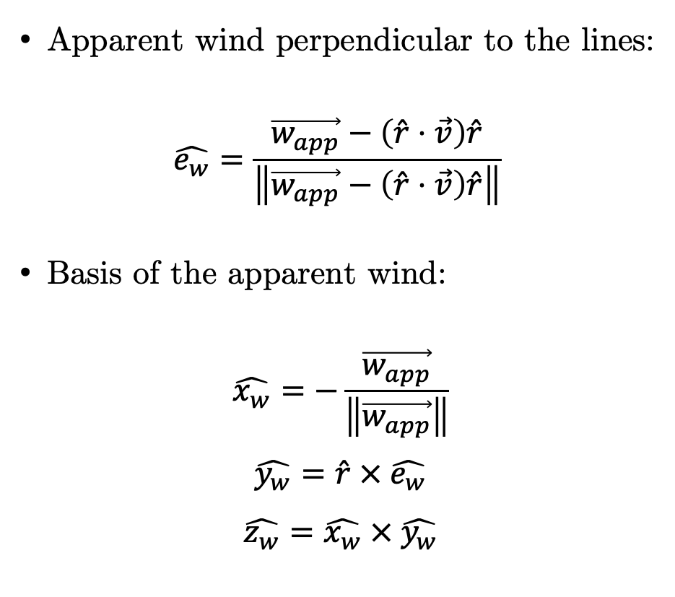
Annex 1: Basis vectors related to the local wind
Apparent wind perpendicular to the lines:
$$\hat{e_{w}}=\frac{\vec{w_{app}}−\left(\hat{r}⋅\vec{v}\right)\hat{r}}{\left\|\vec{w_{app}}−\left(\hat{r}⋅\vec{v}\right)\hat{r}\right\|}$$
Basis of the apparent wind:
$$\hat{x_{w}}=−\frac{\vec{w_{app}}}{\left\|\vec{w_{app}}\right\|}$$
$$\hat{y_{w}}=\hat{r} × \hat{e_{w}}$$
$$\hat{z_{w}}=\hat{x_{w}} × \hat{y_{w}}$$

Slide 21
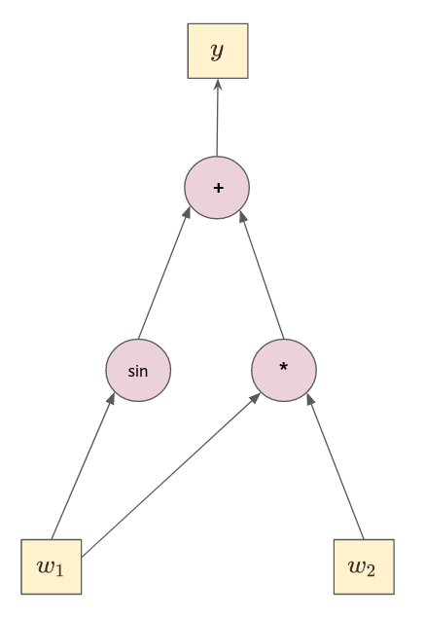
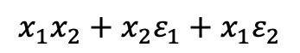
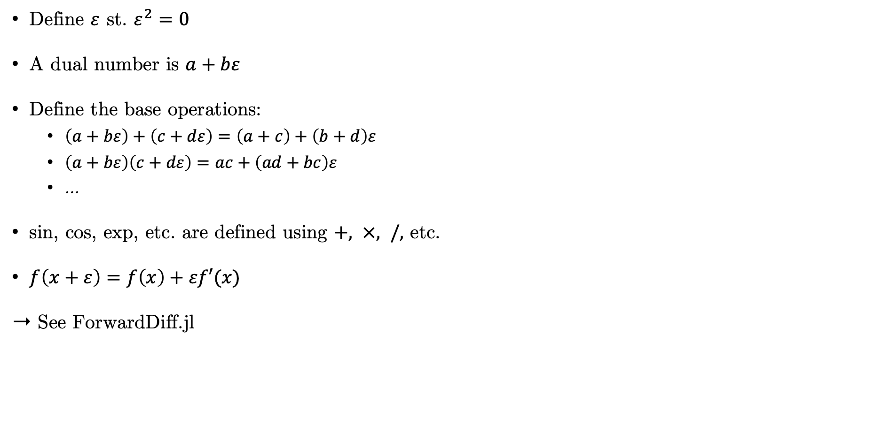
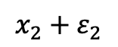
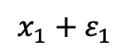
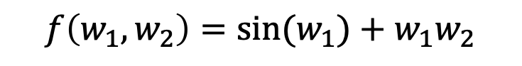
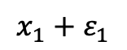
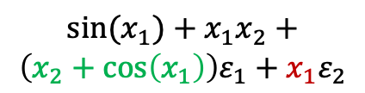
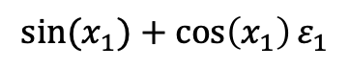
Annex 2: Forward Automatic Differentiation
$$f\left(w_{1}, w_{2}\right)={sin⁡(w}_{1})+w_{1}w_{2}$$
Define $ε$ st. $ε^{2}=0$
A dual number is $a+bε$
Define the base operations:
$\left(a+bε\right)+\left(c+dε\right)=\left(a+c\right)+\left(b+d\right)ε$
$\left(a+bε\right)\left(c+dε\right)=ac+\left(ad+bc\right)ε$
…
sin, cos, exp, etc. are defined using $+, ×, /,$ etc.
$f\left(x+ε\right)=f\left(x\right)+εf′(x)$
➝ See ForwardDiff.jl
$${sin⁡(x}_{1})+x_{1}x_{2}+$$
$$\left(x_{2}+\cos\left(x_{1}\right)\right)ε_{1}+x_{1}ε_{2}$$
$${sin⁡(x}_{1})+\cos\left(x_{1}\right)ε_{1}$$
$$x_{1}x_{2}+x_{2}ε_{1}+x_{1}ε_{2}$$
$$x_{1}+ε_{1}$$
$$x_{2}+ε_{2}$$
$$x_{1}+ε_{1}$$

